Slide 1
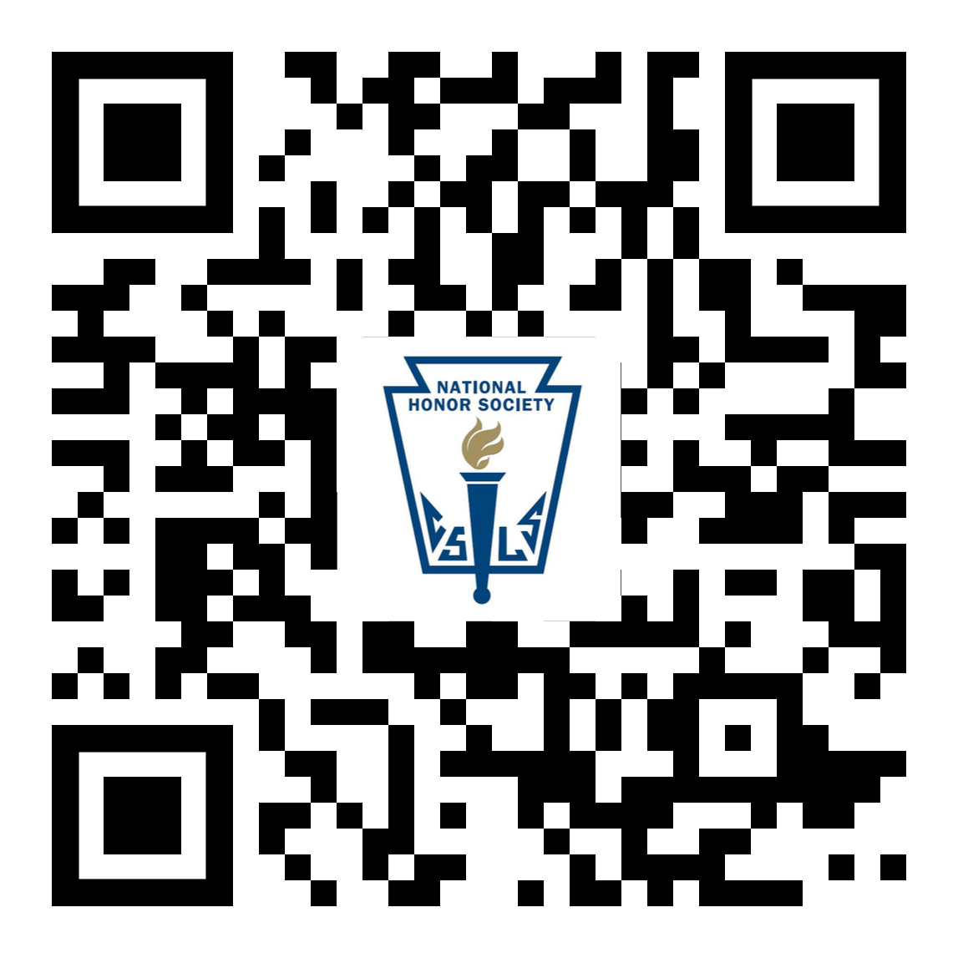
Welcome Members!
NHS Website

Slide 2
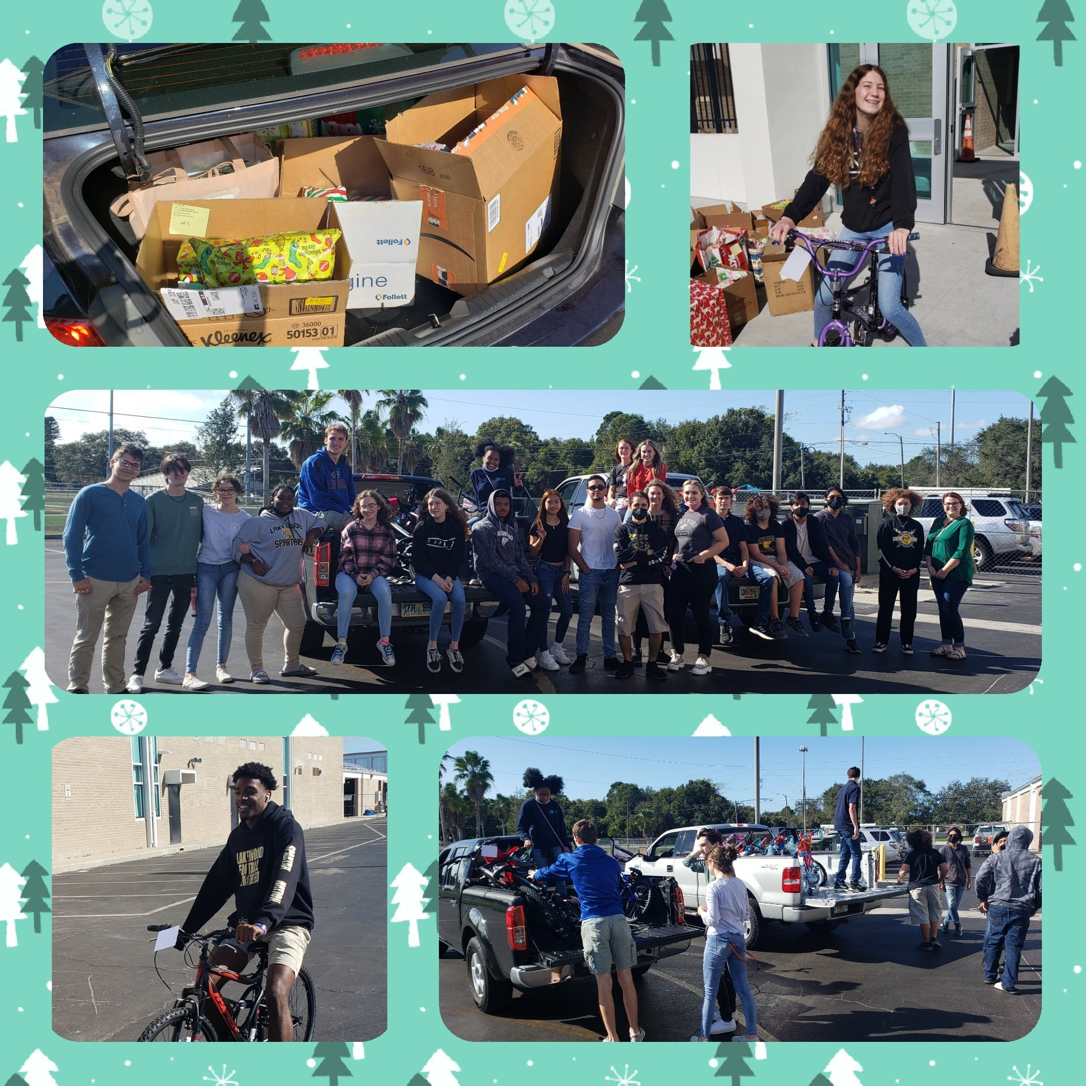
December – The Giving Tree
22 out of 22 children have been sponsored!
HOW TO HELP:
Now – Donate money to any of your groups that are pitching in to buy gifts.
Now - Donate a roll of wrapping paper, bags, bows
12/11 – 12/20 – Begin wrapping gifts during the day, lunch, or after school (Only 15 minutes after school).
12/20 – After exams, bring gifts to Lakewood Elementary School

Slide 3
December Blood Drive
Results:
32 NHS members volunteered
34 students donated blood
13 NHS members donated blood
102 lives will be saved
Great Job! Let’s do it again in February!

Slide 4
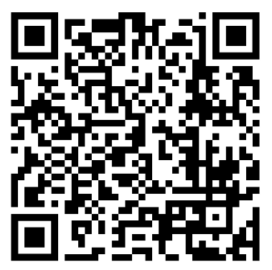
Tutoring
*Ongoing*
Sign up Here:
There are only two weeks before the end of the semester! Sign up now!

Slide 5
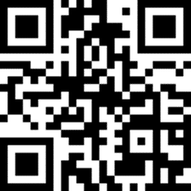
Submitting Hours
Use the QR code in the media center to link directly to the form,
OR
Go to the NHS website to submit your hours
Hours must be submitted by January 11th

Slide 6
Semester Requirements
Attend and participate respectfully in meetings
Contract Signed and Dues paid - $20
Submit your 20 hours per semester of community service hours (only 10 during 1st semester for new members)
Of the 20 hours, 6 hours must be tutoring hours –
3 hours for new members
(ELP, after school care, etc)
Hours must be submitted by January 11th

Slide 7
Upcoming Events:
​12/7 Peace in the Burg Event
12/11 Collab with Bay Vista Elementary
12/11-12/20 Giving Tree gift wrapping
12/20 Giving Tree delivery
12/21 Holiday Celebration during lunch
1/25 Induction

Slide 8
Induction, For Real This Time:
We have gotten the induction date approved and it is set to happen on: JANUARY 25th
Set this date in your calendar and make sure you are prepared!
Meetings for it 2 weeks before and the day of.

Slide 9
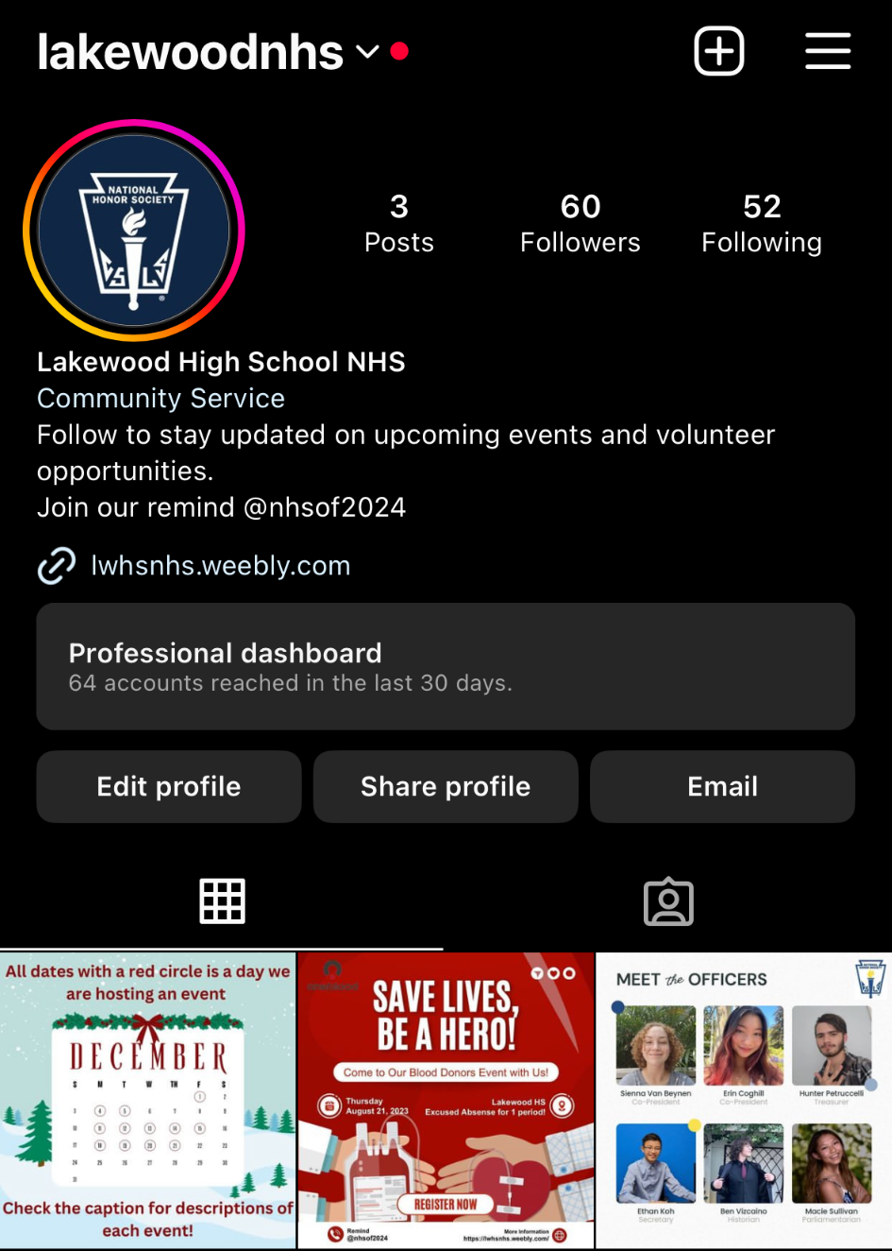
Stay Updated!
Remind: Text 81010 @nhsof2024
Instagram: Follow our instagram for reminders for upcoming events and meetings
@lakewoodnhs
NHS website
https://lwhsnhs.weebly.com/

Slide 10
QUESTIONS/COMMENTS

