Slide 1
NATIONAL HONOR SOCIETY 2023-2024

Slide 2
ALL SEMESTER 1 HOURS ARE DUE TODAY
Visit website for submission forms and hour log

Slide 3
INDUCTION
Thursday the 25th
Main Auditorium Arrive 6:00 pm
Parents let in at 6:15 pm
All new members are required to attend
Dress business casual, button downs, slacks, dresses
Please bring friends and family!

Slide 4
SEQUENCE OF EVENTS
Welcome/Introduction
History of NHS
Pillars of NHS
Candlelight Ceremony pledge/presentation
Principal’s Address
Refreshments

Slide 5
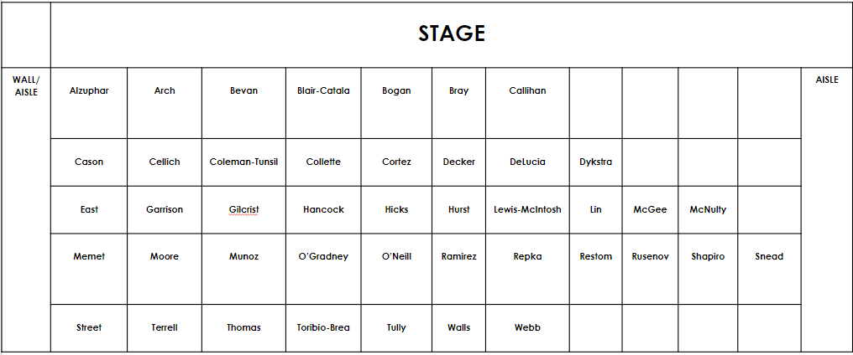
INDUCTEES WILL BE SITTING ON THE LEFT SIDE OF THE STAGE UPON ENTERING THE AUDITORIUM. PARENTS MAY SIT IN THE MIDDLE SECTION.

Slide 7
ELP STARTS BACK UP JANUARY 22ND SIGNUP GENIUS ON WEBSITE

Slide 8
ELP TUTORING

Slide 9
NEW IN SCHOOL TUTORING OPPORTUNITIES
Algebra 1 last 30 minutes of periods 2, 4, 6, or 8
Physics last 30 minutes of periods 6 and 8
Students cannot miss core classes to tutor

Slide 10
TUTORING DURING SCHOOL
Teacher | Subject | Room | Period
Ms. Homan | Research 1 | T202 | 3rd
Mr. Cortez | Research 1 | T112 | 4th
Mr. Ness | Research 2 | T113 | 3rd
Mr. Tencza | Research 3 | T111 | 6th
If you need a quiet place to tutor during these periods, the media center is an available space. Please ensure that you have a pass from both YOUR teacher AND the Research teacher.

Slide 11
BAY VISTA NHS INDUCTION
6 pm in Lakewood main auditorium, arrive early to help set up
Volunteers will assist setting up, ushering parents and inductees, cleaning up

Slide 12
LAKEWOOD NHS SOCIAL MEDIA
Please follow the @lakewoodnhs Instagram account to stay updated on events and information

Slide 13
NHS WEBSITE
https://lwhsnhs.weebly.com/
Event calendar has been updated, events in bold are mandatory.

Slide 14
QUESTIONS AND COMMENTS
For further questions email Mrs. Robinson at Robinsonhea@pcsb.org

