Slide 1
National Honor Society 2023-2024

Slide 2
General Requirements
3.0 unweighted GPA AND 3.5 weighted GPA
Attendance to meetings
1 NHS event a semester
Semesterly hour requirements

Slide 3
Hour Requirements
20 total hours a semester
At least 6 of those hours must be from tutoring
1 NHS event

Slide 4
ELP tutoring

Slide 5
Tutoring during school
Teacher | Subject | Room | Period
Ms. Homan | Research 1 | T202 | 3rd
Mr. Cortez | Research 1 | T112 | 4th
Mr. Ness | Research 2 | T113 | 3rd
Mr. Tencza | Research 3 | T111 | 6th
If you need a quiet place to tutor during these periods, the media center is an available space. Please ensure that you have a pass from both YOUR teacher AND the Research teacher.

Slide 6
dues
20 dollars
Bring to Mrs. Robinson
Due by November 30th

Slide 7
SHORT-NOTICE Service Opportunity!
Monday, November 13th
Partner with NJHS at Bay Vista Elementary
Meet the younger generation of NJHS and speak with them about what NHS looks like in high school
Make Thanksgiving cards with the NJHS members for a local nursing home
Details
Arrive at 2:15 (meeting starts at 2:30)
Park across the street and walk over (lots of cars due to dismissal)
Bring your ID and check in at the front office

Slide 8
December Blood Drive
NHS EVENT!!!
WHEN?
December 5th
(and 3 days leading up to it)
HOW?
Encourage students to sign up (during lunches)
Help the day of the blood drive (during the school day)
Donate blood

Slide 9
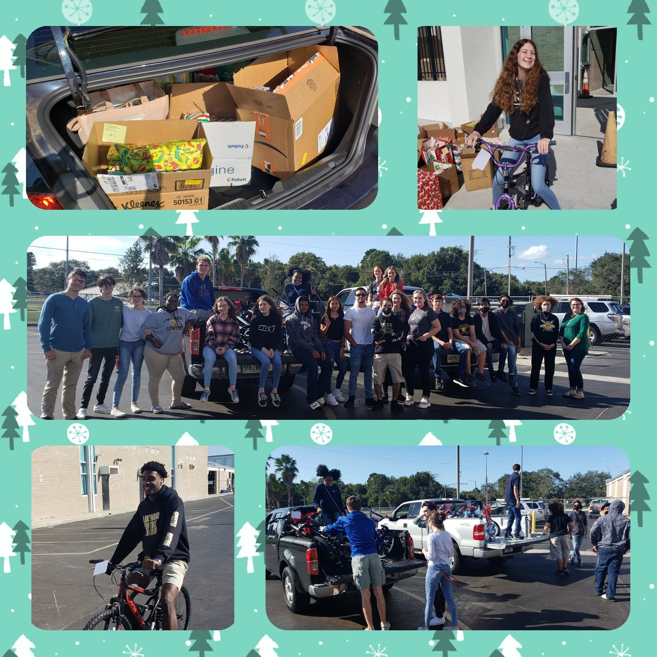
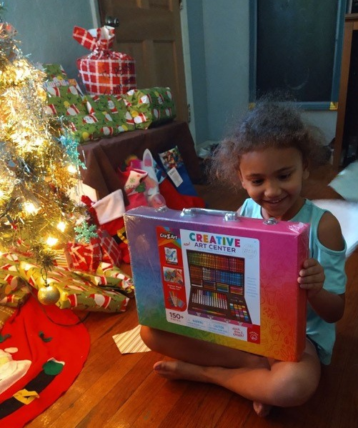
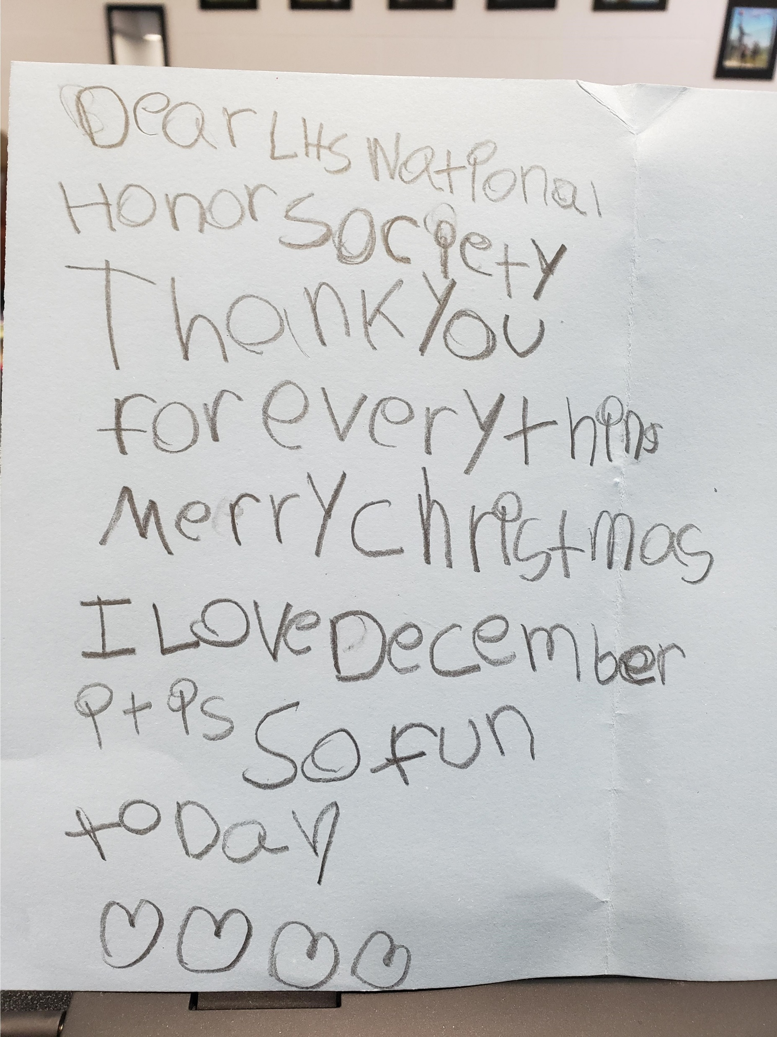
December – The Giving Tree
NHS EVENT!!!

Slide 10
ELP signup

Slide 11
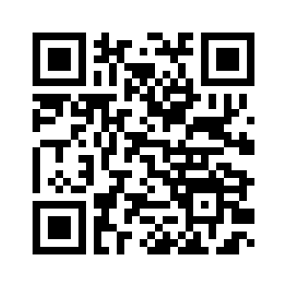
Remind
@nhsof2024

Slide 12
NHS Website
https://lwhsnhs.weebly.com/

Slide 13
Questions and comments
For further questions email Mrs. Robinson at Robinsonhea@pcsb.org

